Slide 1
Unit 2
Lecture 2
Inheritance in java, Overriding, Use of super, Abstract class, Interfaces, Packages, Importing packages, Exception handling in java, Use of try, catch, finally, throw in exception handling. Multithreaded programming, Thread life cycle, Thread priorities, Thread synchronization

Slide 2
Method Overriding
Definition: When a subclass defines a method with the same name, return type, and parameters as a method in its superclass, it overrides the superclass method.
Purpose: To allow runtime polymorphism and customize behavior for subclass objects.

Slide 3
Rules for Overriding
The method in the subclass must have the same signature (name + parameters) as in the superclass.
The return type must be the same or a subtype (covariant return).
The method must not be less accessible than the overridden method (e.g., public cannot be overridden with protected).
The method cannot be overridden if it's declared final,static , or private.
The overriding method can throw fewer or no checked exceptions than the overridden method.

Slide 4
Method overriding
class Animal {
void sound() {
System.out.println("Animal makes a sound");
}
}
class Dog extends Animal {
@Override
void sound() {
System.out.println("Dog barks");
}
}

Slide 5
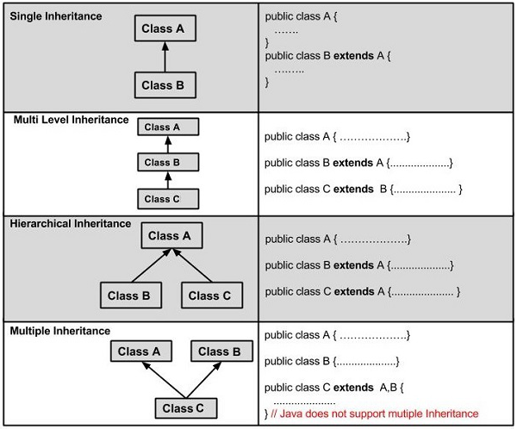

Slide 6
Type of Inheritance | Structure / Diagram | Description | Example Syntax
Single Inheritance | Animal → Dog | One subclass inherits from one superclass | class Dog extends Animal {}
Multilevel Inheritance | Animal → Dog → Puppy | A class inherits from a class that itself inherits another. | class Puppy extends Dog {}
Hierarchical Inheritance | Animal → Dog and Animal → Cat | Multiple classes inherit from a single superclass. | class Dog extends Animal {} class Cat extends Animal {}
Multiple Inheritance (Interfaces) | Interface A → Interface B → Class C | A class implements multiple interfaces | class C implements A, B {}
Hybrid Inheritance | Combination of above | Mix of multiple types using interfaces. | class D extends C implements A, B {}

Slide 7
abstract class
In Java, an abstract class is a class that cannot be instantiated on its own and is meant to be extended by other classes. It often serves as a blueprint for subclasses, especially when you want to enforce certain methods but leave their implementation to child classes.

Slide 8
Key Features of Abstract Classes:
Declared using the abstract keyword.
Can contain abstract methods (without a body) and concrete methods (with a body).
Cannot be instantiated directly.
Subclasses must implement all abstract methods unless they are also abstract.

Slide 9
When to Use Abstract Classes:
When you want to define a common interface but also share some code.
When you expect subclasses to provide specific implementations of certain behaviors.
When you want to prevent direct instantiation of a base class.

Slide 10
abstract class Shape
{
int dim1, dim2;
Shape(int d1, int d2)
{
dim1 = d1;
dim2 = d2;
}
// Abstract method (no body)
abstract void printArea(); // Concrete method (optional)
void displayDimensions()
{
System.out.println("Dimensions: " + dim1 + ", " + dim2);
}}

Slide 11
Explanation by Component
abstract class Shape | Declares a base class that cannot be instantiated directly. It's meant to be extended by specific shape classes like Rectangle, Triangle, etc.
int dim1, dim2; | These are protected dimensions (e.g., length, breadth, radius, height) used by subclasses to calculate area.
Shape(int d1, int d2) | A constructor that initializes the dimensions. Subclasses will call this using super(d1, d2).
abstract void printArea(); | An abstract method—no body here. Subclasses must override this to provide shape-specific area logic.
void displayDimensions() | A concrete method that prints the dimensions. Subclasses inherit this as-is.

Slide 12
Subclass Example
class Rectangle extends Shape
{
Rectangle(int length, int breadth)
{
super(length, breadth);
}
// Must implement abstract method
void printArea()
{
System.out.println("Area of Rectangle: " + (dim1 * dim2));
}
}

